Slide 1
Speech Recognition in HTML and CSS
Machine Learning
JAYDEEP KRISHNA,BARATH BALAJI

Slide 2
Speech Recognition in HTML and CSS will be an effective way in designing websites.

Slide 3
INTRODUCTION TO MACHINE LEARNING
Machine learning, a subset of artificial intelligence, refers to systems that can learn by themselves. It involves teaching a computer to recognize patterns, rather than programming it with specific rules.

Slide 4

Machine Learning
“Field of study that gives computers the capability to learn without being explicitly programmed”.

Slide 5
How Machine Learning works?
Machine learning is a form of artificial intelligence (AI) that teaches computers to think in a similar way how humans do: learning and improving upon past experience

Slide 6
It works by exploring data, identifying patterns, and involves minimal human intervention

Slide 7
SPEECH RECOGNITION
Speech recognition is an subfield of computational linguistics that develops methodologies and technologies that enables the recognition and translation of spoken language into text by computers.

Slide 8
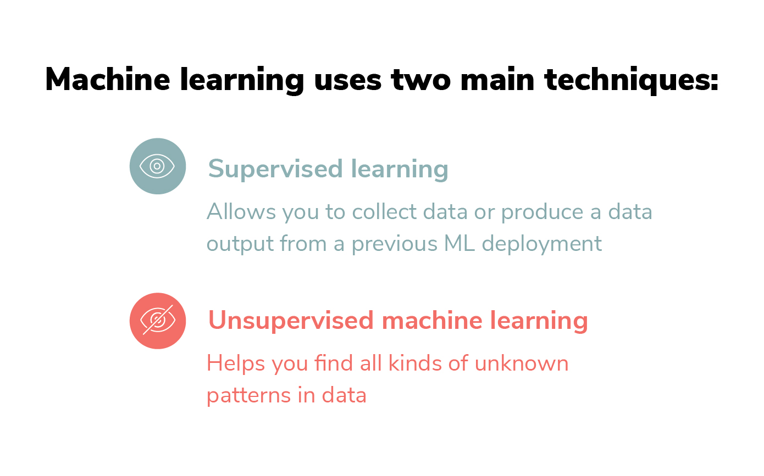

Slide 9
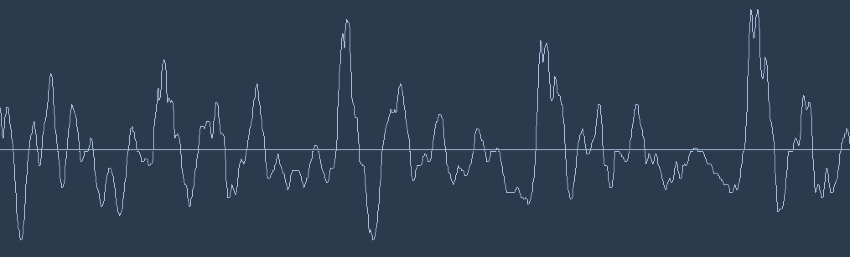
USING VOICE COMMANDS IN DESIGNING A WEBSITE
“The way you handle speech commands is the way you design your website”

Slide 10
Before starting to design the website the user must save his/her .html, .Css files along with the images, videos and whatsoever to be used in a separate folder.

Slide 11
Advantages:
Anyone without a basic programming language can design a responsive and a creative website.
No programming language knowledge is required.
Minimize the work effort, and cost.
Disadvantages:
Must use the specified key-words in the required places.
Recognizing speech is a hard problem. 3. You will need a lot of training data.

Slide 12
THANK YOU!

